Slide 1
Raspberry Pi based
Hibotics Device
Tyler Bovenzi
Conor Sefkow

Slide 2
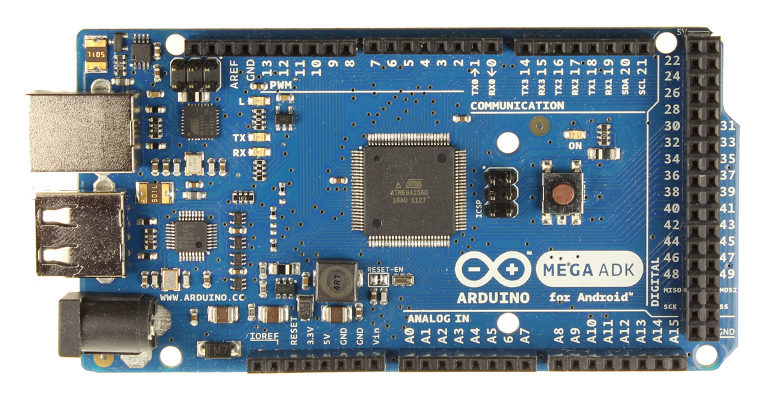
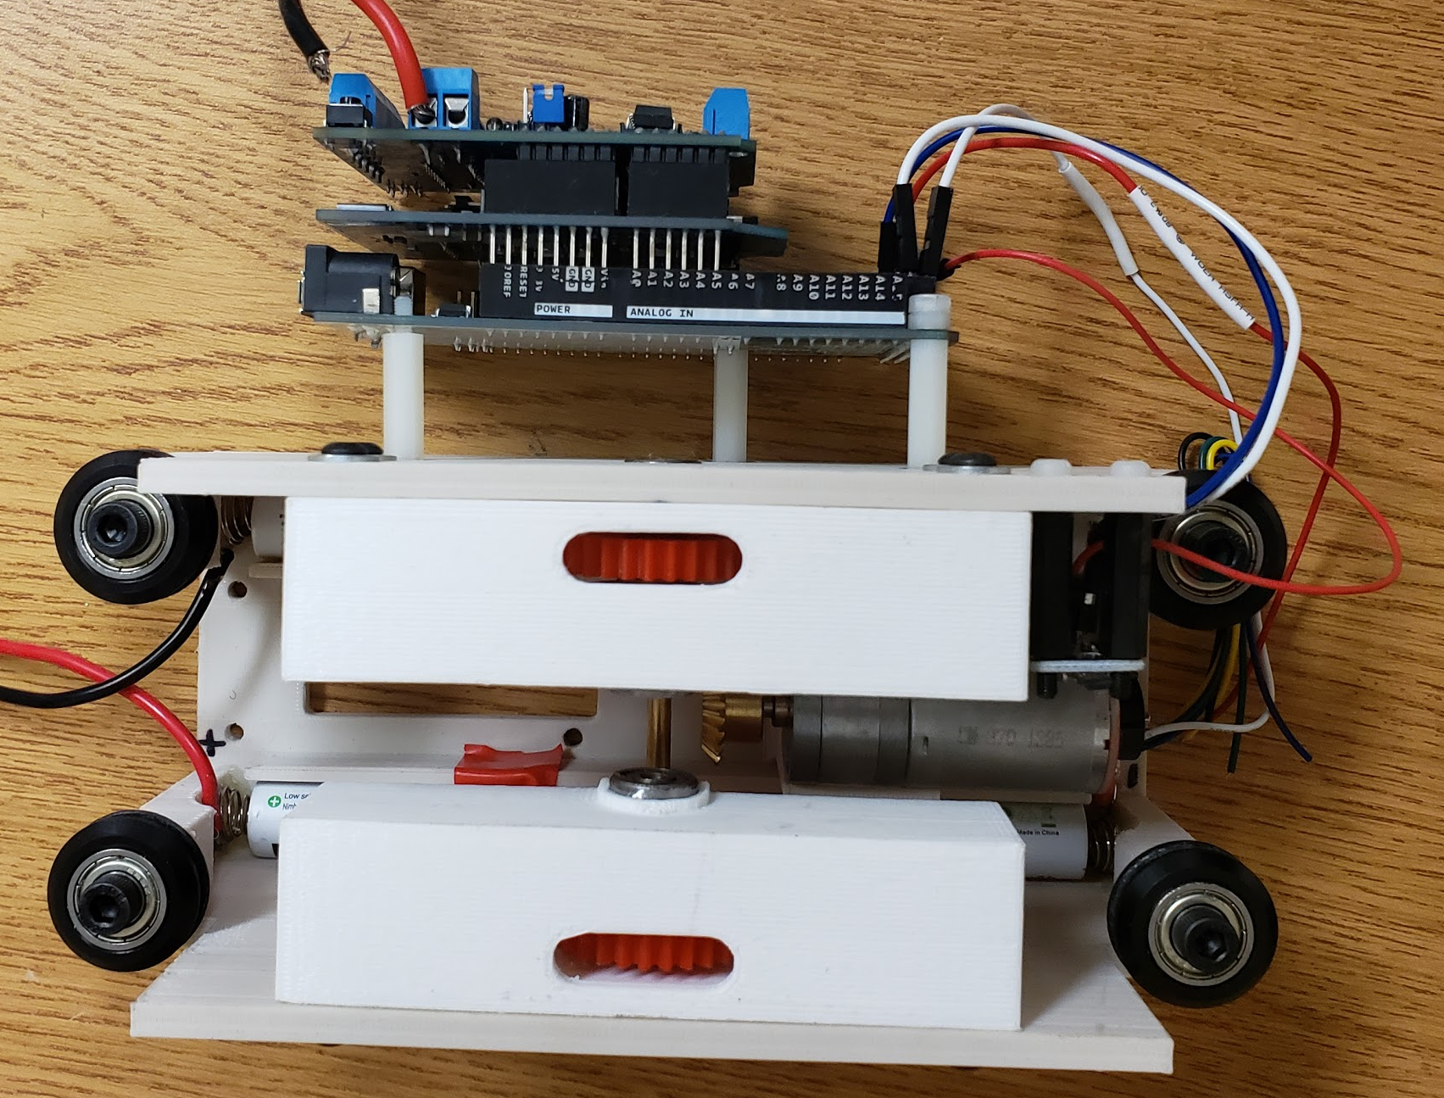
Background
- The Elevated Robotic Assistive Device (ERAD) is a smart-home Internet of Things (IOT) device
- Includes functionality such as voice recognition, autonomous and manual control, camera for video and photos, and modularity to include additional sensors/features

Slide 3
Overall Changes
New Raspberry Pi based control structure, allowing for faster processing and supported integration with Python and Speech/Image recognition
Custom daughter board (hat) that provides motor and sensor control.
Adaptable power input for new and old power supplies.
Replaced Alexa Dot with microphone and hearing algorithms.
Camera and computer vision without phone attached.
Support for analog and digital sensors as well as Linux based OS.
Improved UI for remote control and dynamic settings.

Slide 4
Raspberry Pi over Arduino
Benefits:
Better clock speed, memory, storage, etc.
Linux based OS, more powerful than previous arduino architecture.
Compatible with python and its libraries, and thoroughly documented.
Support for image and speech recognition.
Limitations:
No internal ADC (analog → digital converter)
Not natively compatible with all pre-existing components on earlier versions.

Slide 5
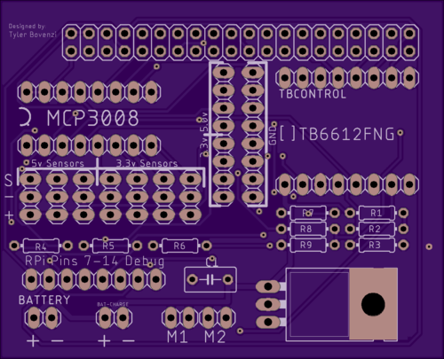
RasPi Hat Features (V1)
GPIO connection to Pi
Sensor and ADC connections
Motor Driver (TB6612FNG)
Additional ports for future integration
Battery Input and Motor Output
Regulating power supply

Slide 6
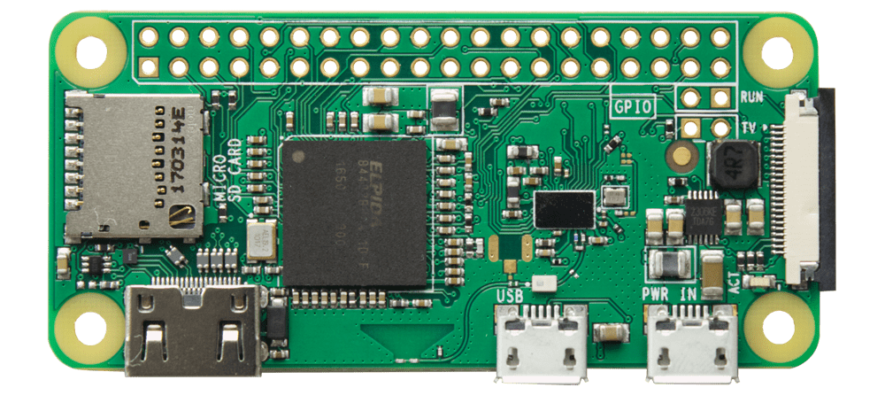
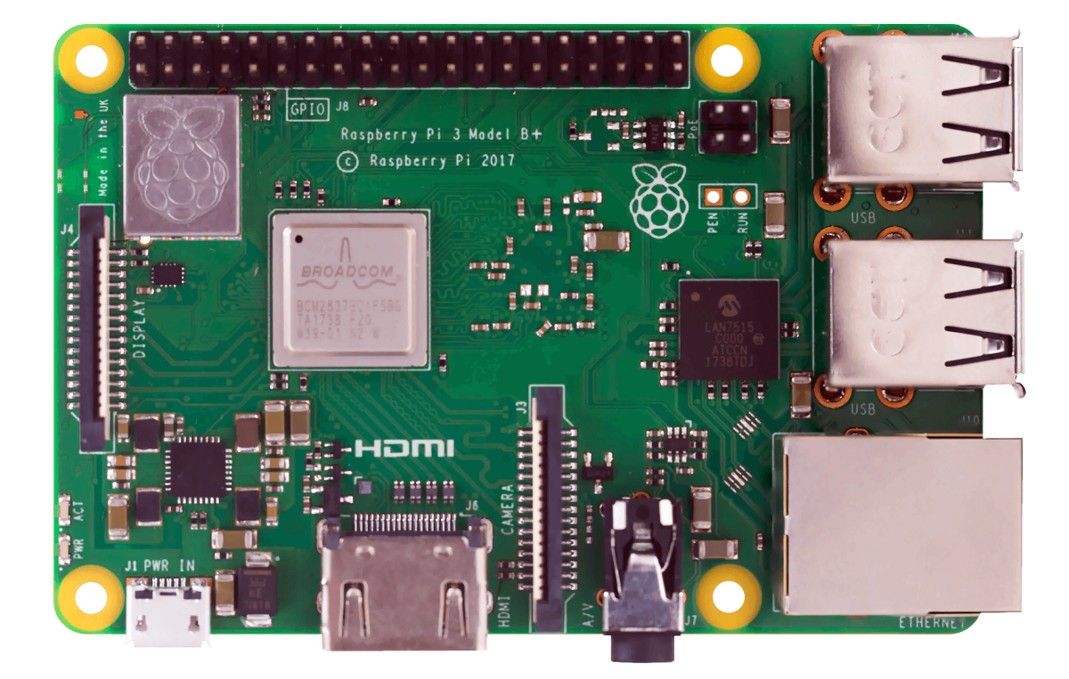
Control Optimization
Pi Zero W over Pi 3 B+
Benefits: - $10/unit vs $35/unit → much cheaper to produce with Zero W - Enables smaller/more compact design - Still houses integrated Wi-Fi and sufficient I/O
Limitations: - Significantly less processing power & half the RAM - Less space to develop daughter board (hat)
Raspberry Pi Zero W
Raspberry Pi 3 B+

Slide 7
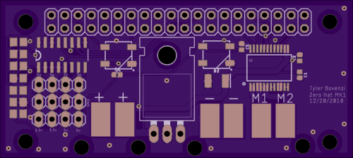
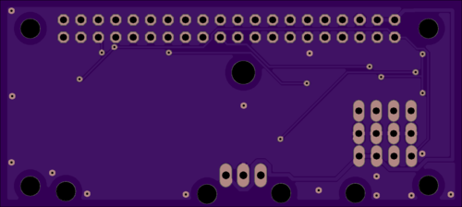
RasPi Zero Hat Features (V2)
All features in V1 have been added and expanded upon.
Smaller Form factor
Use of surface mount components, takes up less space, cheaper to produce.
Made specifically for pi zero; also compatible with bulkier 3B+.
RGB status lights for easy debugging

Slide 8
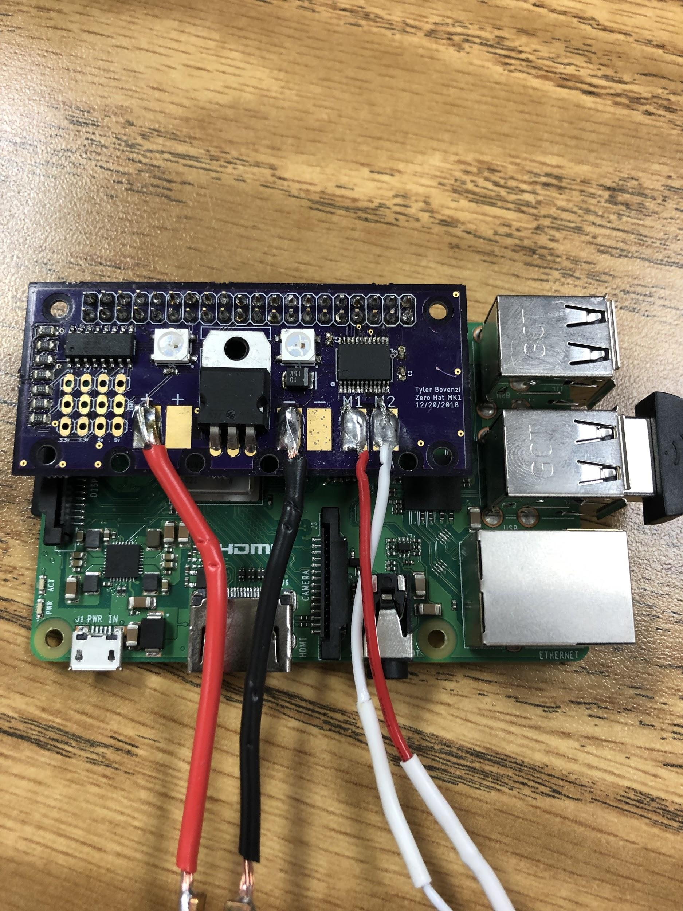
Surface Mount Manufacturing
Smd parts can be used to create a compact pcb, with an alternative soldering method.
Solder paste is spread on top of pads using a stencil made specifically for the pcb.
Components are placed on the solder paste and aligned with the respective pads.
A hot plate or reflow oven heats the paste, causing it to set and turn a shiny, silver color.

Slide 9
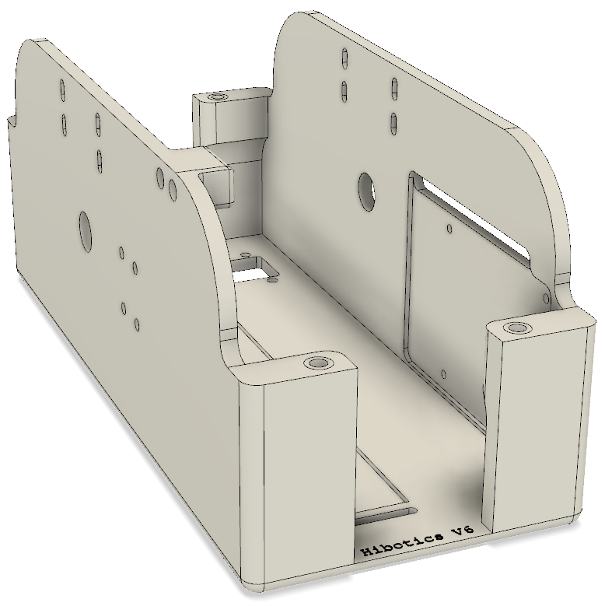
Chassis V6
A major upgrade to the current chassis—all of the functions of the V5, plus:
Dedicated location for Hall Effect sensor
Interior mounting location compatible with both Raspberry Pi and Pi Zero
5200mAh / 7.4 V battery for extended use

Slide 10
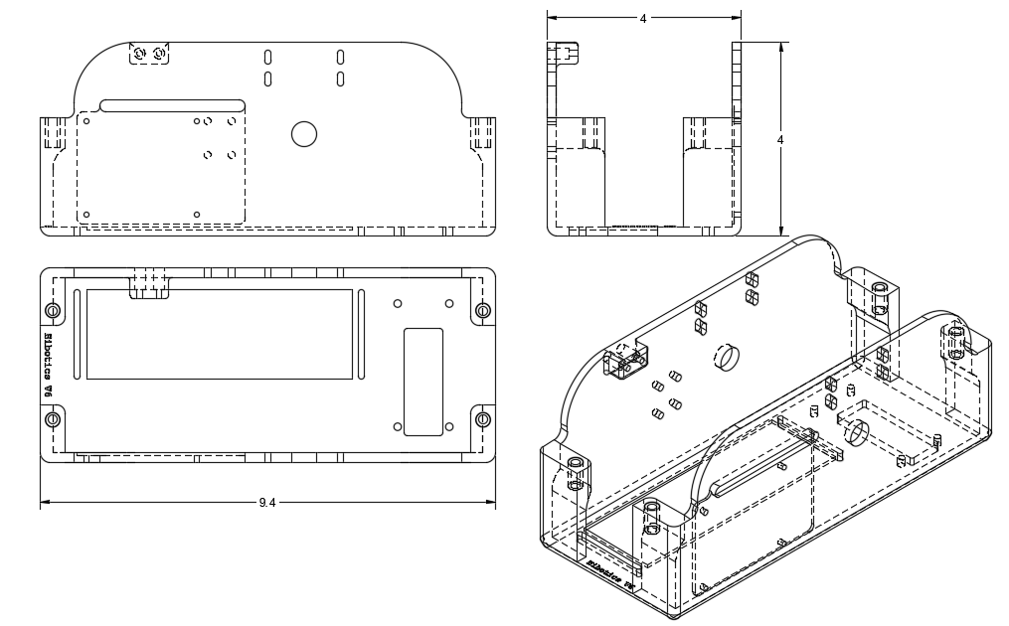
Chassis V6
3D-printed chassis measures 9.4” long x 4” wide x 4” tall
- 2.4” longer, .4” taller, and .9” wider than the V5
- Compatible with current rail
- Larger size allows for bigger battery and interior mounting of electronics

Slide 11
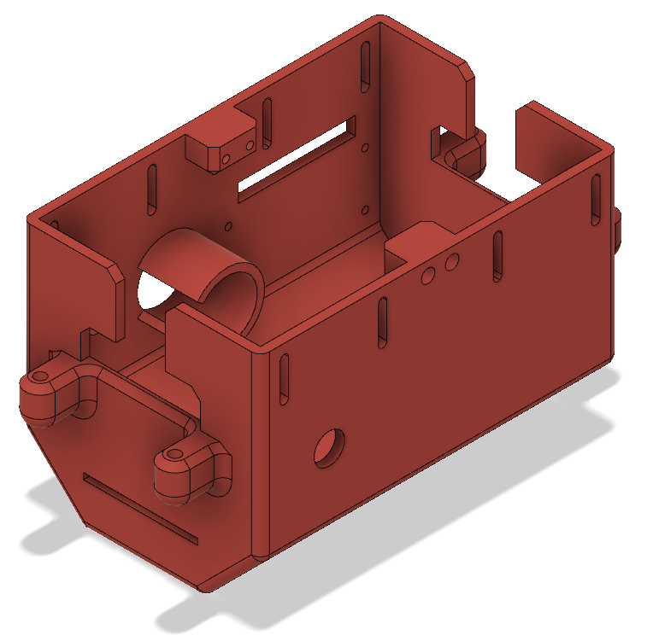
Chassis V6.1
A cheaper alternative to the V6
6” long chassis (V6 is 9.4”) is cheaper and more compact
Pi Zero offers most of the functionality of the 3B+ at a fraction of the size
Horizontally mounted motor eliminates need for bevel gears
4 wheels (not pictured) increase stability

Slide 12
V6 vs V6.1
Chassis | V6 | V6.1
Dimensions | 9.4” x 4” x 4” | 6” x 4” x 4” w/ beveled sides & external wheel mounts
Raspberry Pi | Raspberry Pi 3B+ capable of facial and speech recognition, including all Pi Zero features | Raspberry Pi Zero capable of motor control and WiFi communication
Processing | 1.4GHz quad-core processor; 1GB RAM | 1GHz single-core processor; 512MB RAM

